Slide 1

社群媒體資料分析實務
學號：M10515031
姓名：黃佳郁
老師：毛敬豪
日期：2016/10/31

Slide 2


建構個人資料分析平台(1/3)
Environment:
OS: 64bit Windows 10 家用版
CPU: Intel Core i7-6500U
RAM: 8GB
Container Version: Docker Toolbox
Installing Steps:
Download “Docker Toolbox” from website https://www.docker.com/products/docker-toolbox
Download “docker-compose.yml”
Command “docker-compose up –d”
Execute with command “docker-compose up”
Make sure the platform works or not

Slide 3
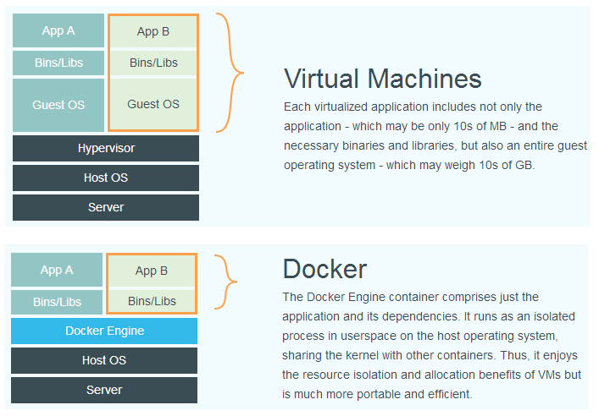
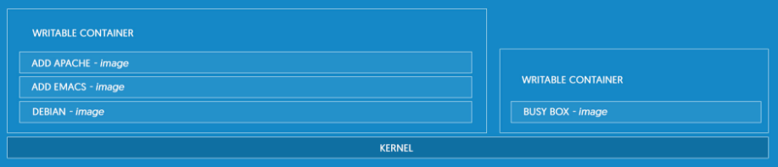
建構個人資料分析平台(2/3)
Introduction of Docker:
An application level container
Package the application into a standard unit for software development

Slide 4
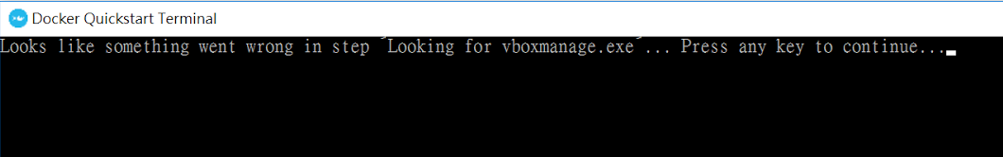
建構個人資料分析平台(3/3)
Problem:
The first time I installed, it showed me …
After I reinstalled it for several times, the problem was fixed.
Then, the problem was solved.
Anaconda:
Download from https://www.continuum.io/downloads

Slide 5
The amount of Twitters and Tweets
Keywords: security, infosec, detection, malware, virus, hacker, anti, defense
Time Range: 2010/01 – 2010/12
RESULT
The amount of Twitters: 35
The amount of Tweets: 1305

Slide 6
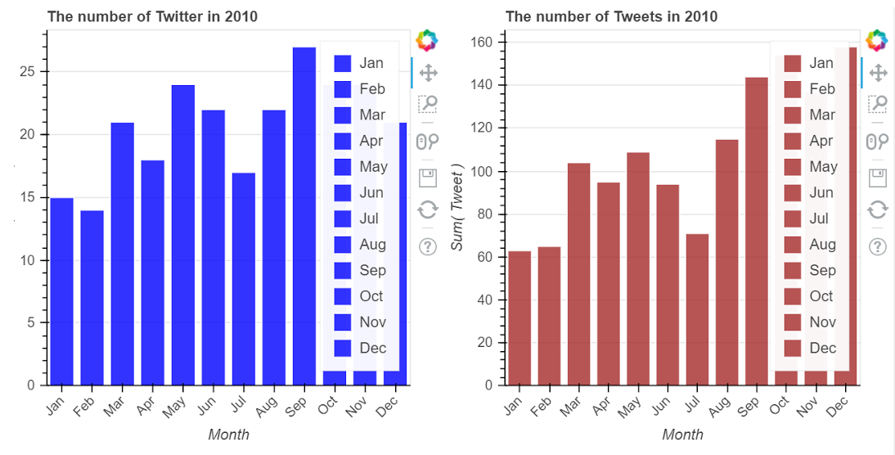
The amount per month

Slide 7
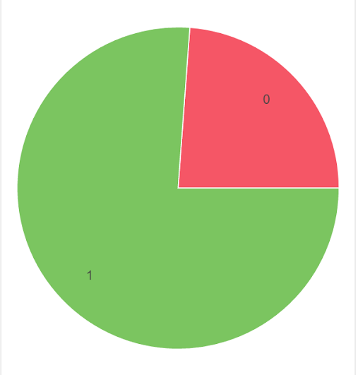
The proportion of Tweets with URL
0: Without URL
1: With URL

Slide 8
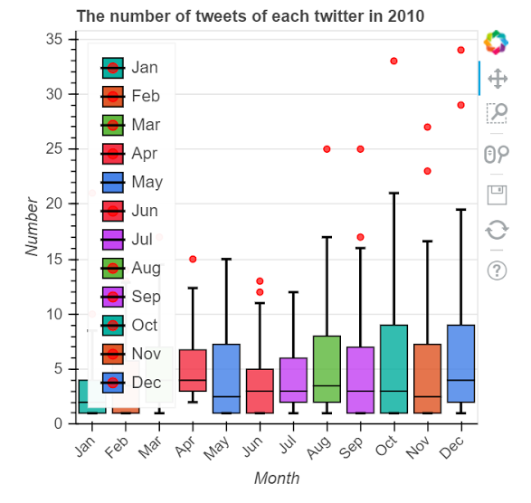
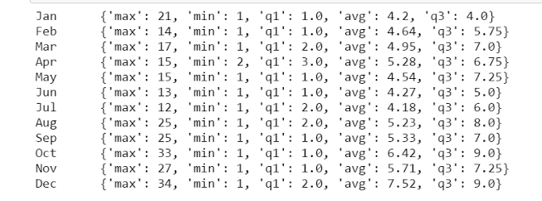
Monthly amount of Tweets of Twitters

Slide 9
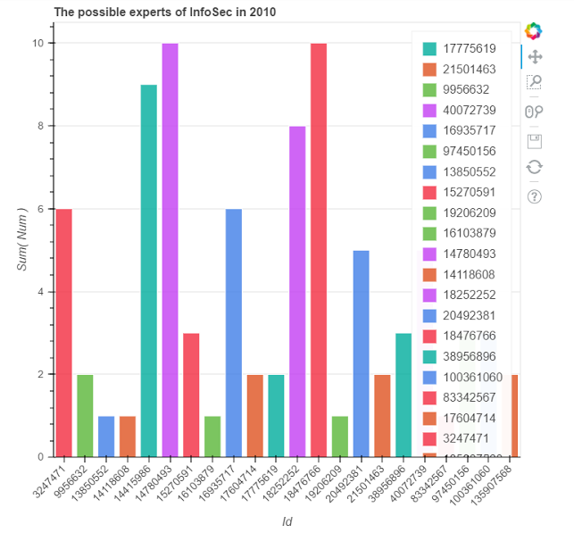
Index Twitter
These Twitters are who tweet more than the
average amount for at least 1 month. The chart
shows the number of months Twitters tweet
exceed the average number.

Slide 10
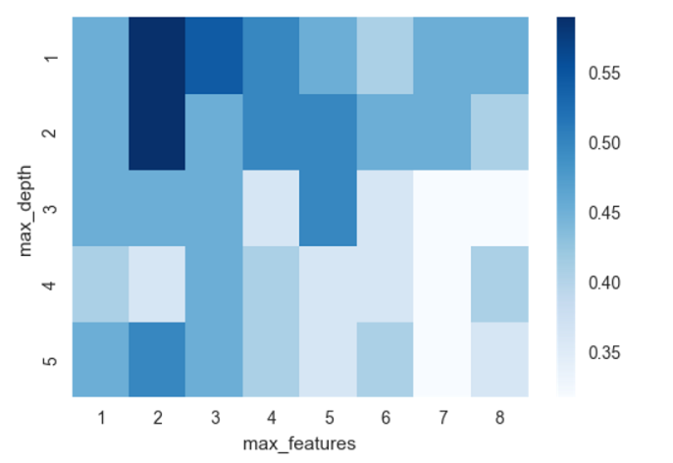
Choose 22 Twitters to analyze

Slide 11
參考資料
https://www.docker.com
https://docs.docker.com/docker-for-windows/
https://philipzheng.gitbooks.io/docker_practice/content/introduction/what.html

